Slide 1
PROJECT NAME – ALLERGY DETECTOR

Slide 2

Team Name - Editox
Team Members,
Sangita Mondal (Leader)
Amrita Bhattacharjee
Sohini Sarkar

Slide 3






Introduction
Allergy is a type of condition in which our immune system abnormally reacts.
This project mainly includes 6 different types of allergies: food allergy, skin
allergy, asthma allergy, dust allergy, allergic rhinitis, contact dermatitis.
Immune system produces substances that are known as antibodies. When
anyone has any kind of allergies, immune system produces antibodies and
these antibodies identify particular allergen.
The Following Types of Allergies are-
Food Allergies
Allergic Asthma
Drug Allergy
Dust Allergy
Skin Allergy
Allergic Rhinities

Slide 4

Objective of the Project
Following are the objectives of this allergy detector:-
It detects different types of allergies.
It can help to avoid deaths caused due to allergy (like asthma).
It provides contactless detection.
It provides user friendly interface for detecting allergies

Slide 5

PROTOTYPE
Input
Monitor
Allergen Measurement
yes
No
Determination of Allergy
No Allergy

Slide 6
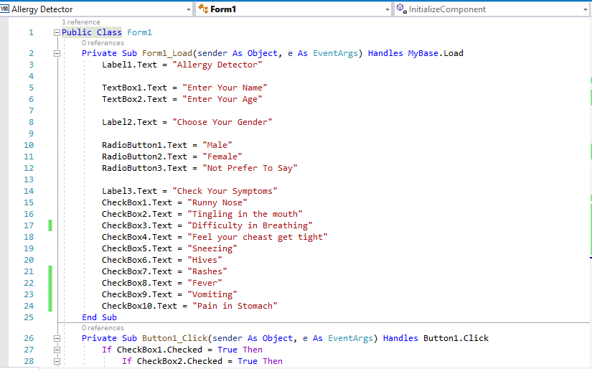

Slide 7
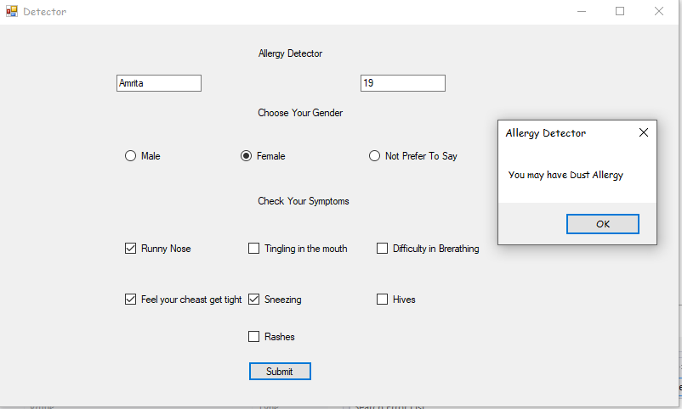
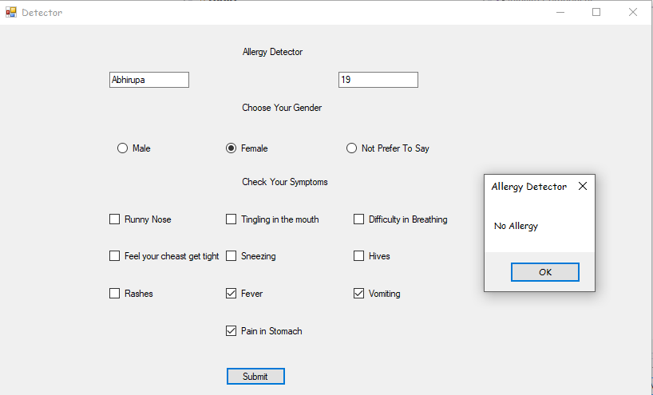
Output

Slide 8

Societal Aspects
Under this pandemic situation it’s not always possible to us to go to any clinic for testing allergies after having any kind of allergic symptoms, this system can be used for the following causes:-
This system can be accessed anytime
If this system is used, primarily no need to visit doctor
Less expensive
It takes less time.
This system / project helps us to detect allergies from home itself.

Slide 9
People suffer from many kind of allergies.
Sometimes they don't concern about the symptoms of allergies but it may effect their health.
This project helps to detect allergies (mainly 6) easily and protects our bodies from the major effect of allergies (mainly 6). This will help us in future to save from severe health problems by allergies (mainly 6).
CONCLUSION

Slide 10
THANK YOU

